Slide 1


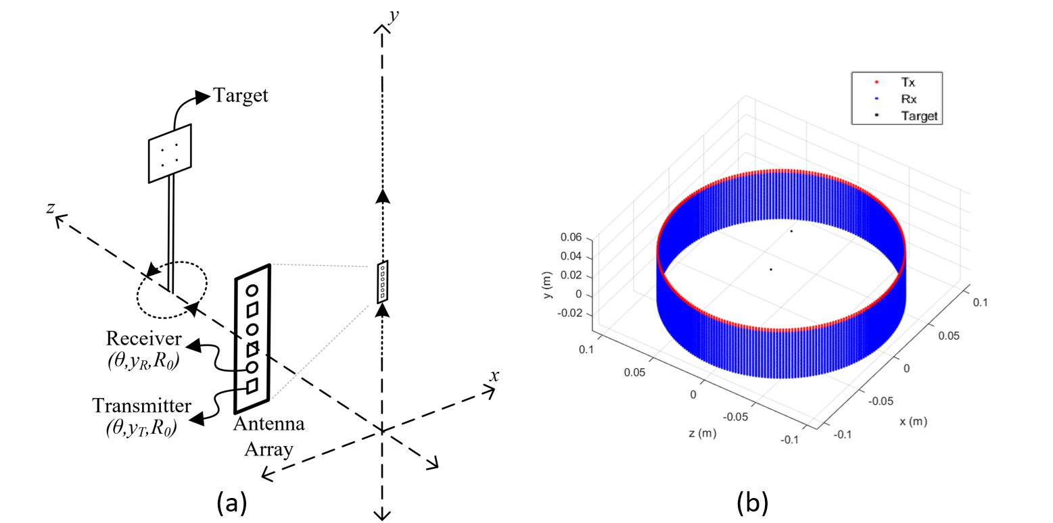
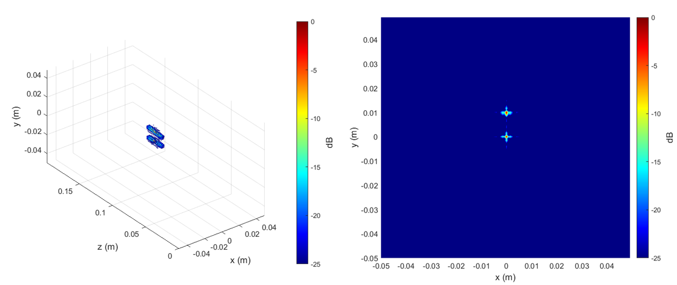
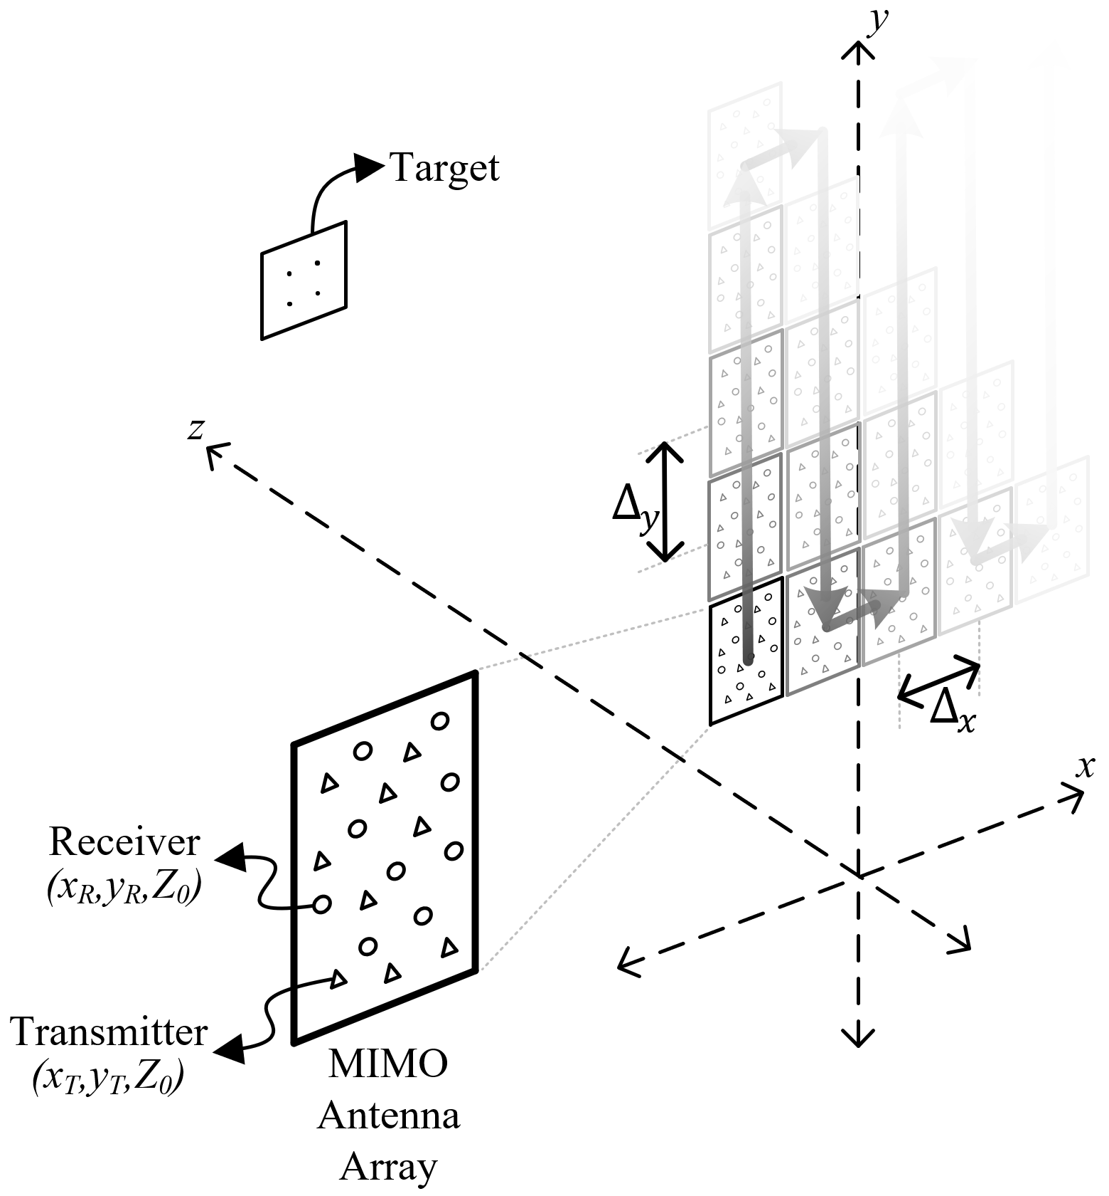
Terahertz Imaging Toolbox with Interactive User Interface
OBJECTIVE: Develop framework to efficiently prototype near-field THz imaging systems, develop image reconstruction algorithms, and generate high-fidelity 3-D image datasets.
APPROACH: Create MATLAB simulation user interface and API for accessible implementations of simulation and image reconstruction algorithms.
Four scanning geometries
Planar, linear, cylindrical, circular
Create Tx Waveform
Carrier frequency, bandwidth, modulation scheme, etc.
Antenna Array + Gain Pattern
Custom 3-D Target Scenes + Echo Signal Simulation
Efficient Image Reconstruction
RESULTS: Enables rapid prototyping of THz imaging systems, increases accessibility of simulation and image reconstruction algorithms, and allows for easy access to meaningful data for machine learning applications.

Slide 2
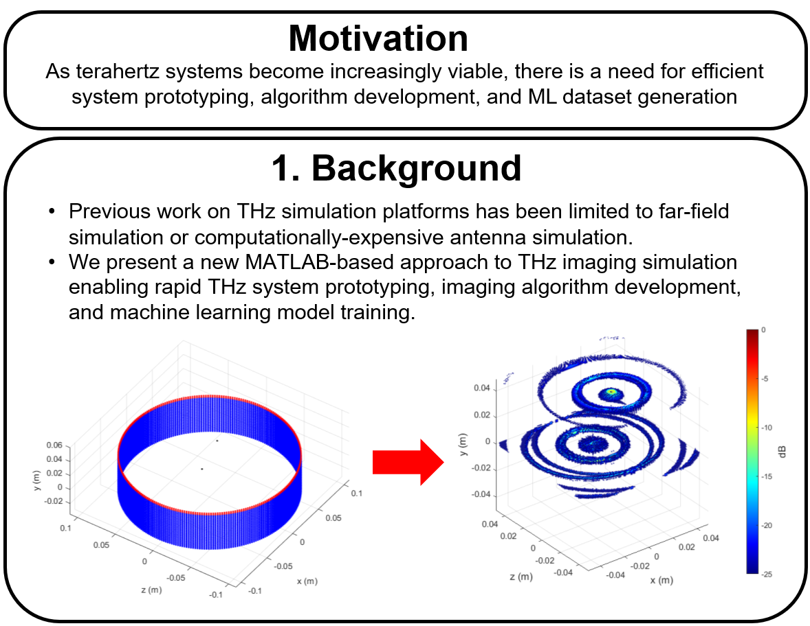

Slide 3
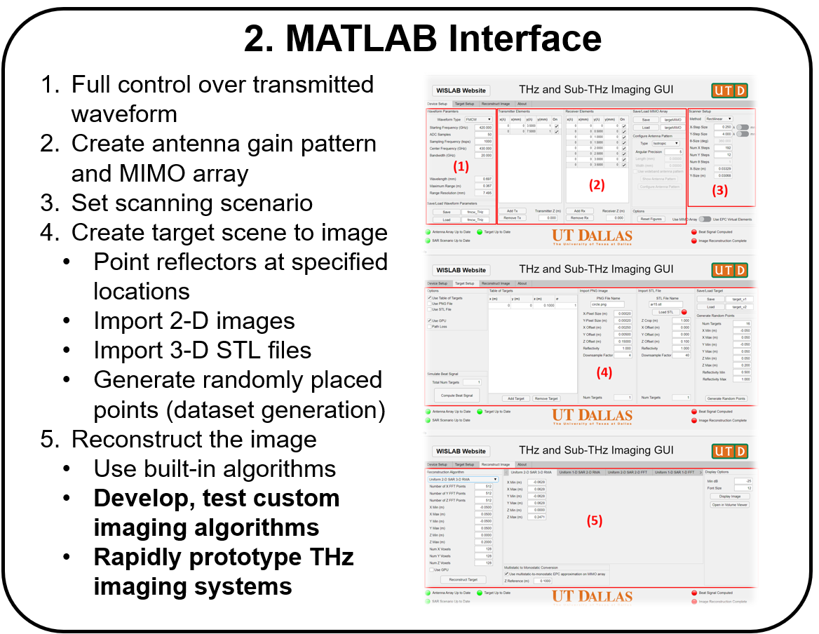

Slide 4
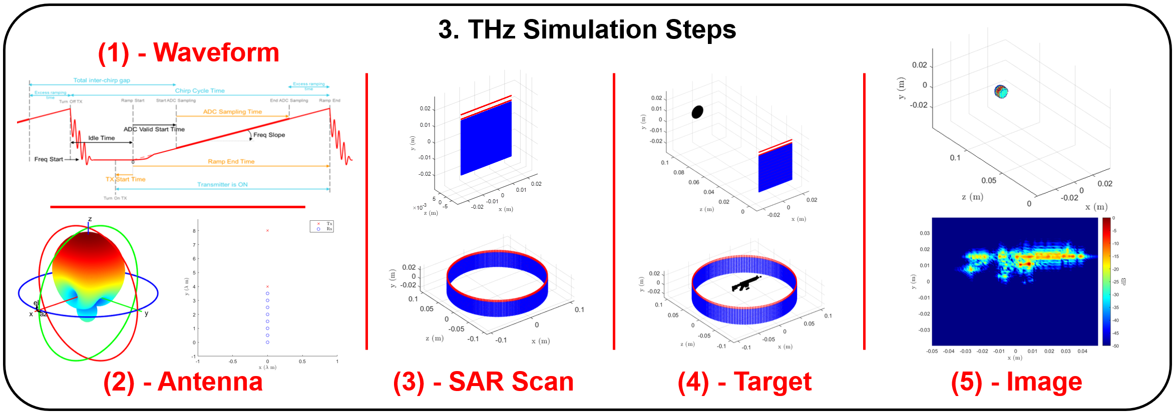
Simulation Steps

Slide 5
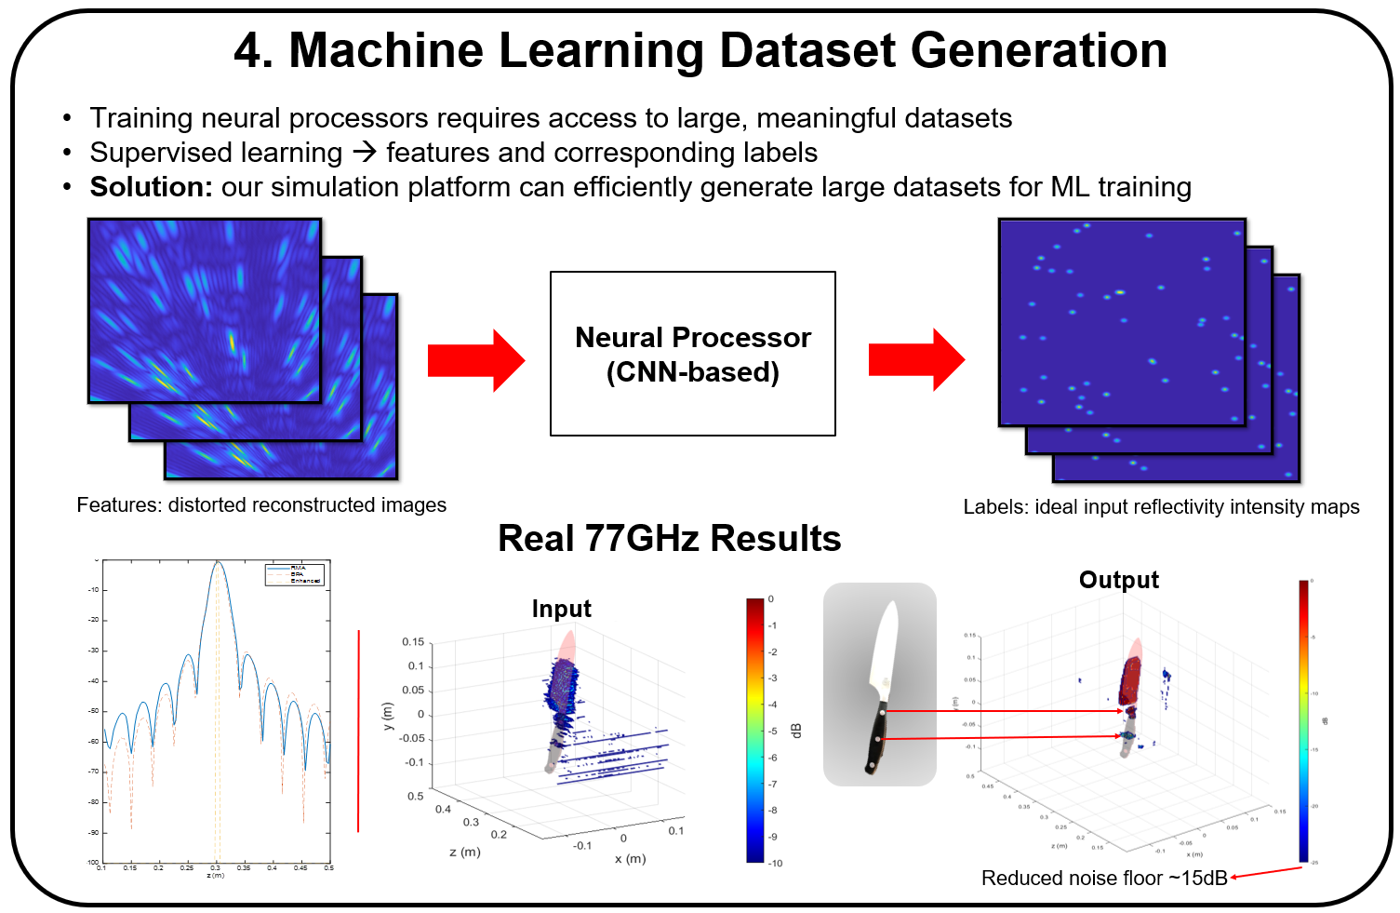

Slide 6
